Slide 1
AWS
Fundamentals

Slide 3

What is Cloud Computing?

Slide 4

Cloud Computing
Characteristics
On-Demand
Broad Network Access
Resource Pooling
Rapid Elasticity
Measured Service
Service Models
Infrastructure as a Service
Software as a Service
Platform as a Service

Slide 5
On_DEMAND

Slide 6
Broad Network Access

Slide 7
Resource Pooling

Slide 8
Rapid Elasticity

Slide 9
Measured Service

Slide 10
Regions

Slide 11
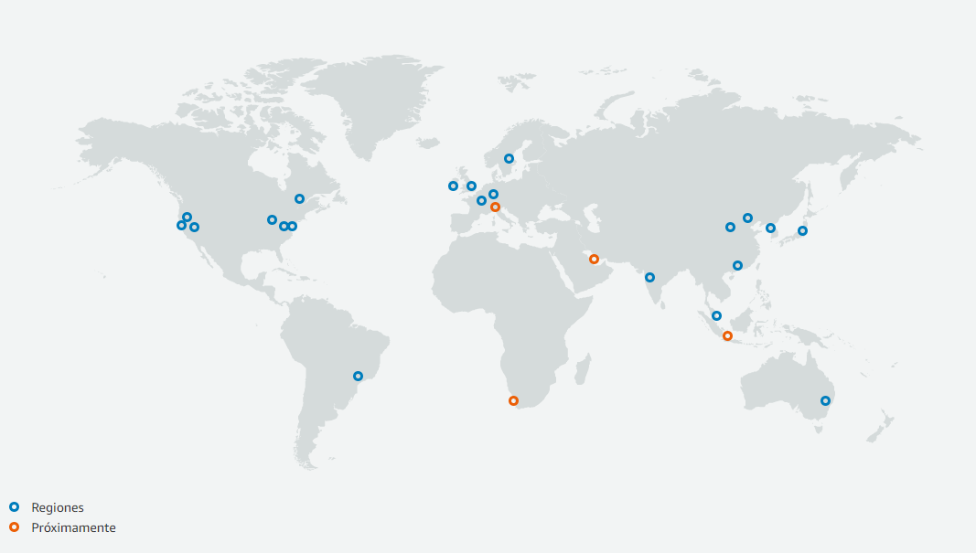

Slide 12
Availability zone

Slide 13
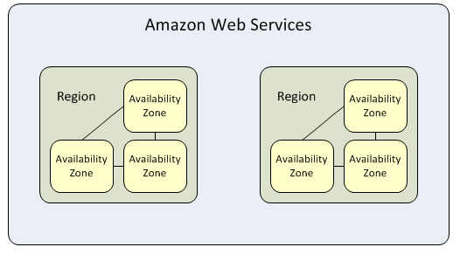
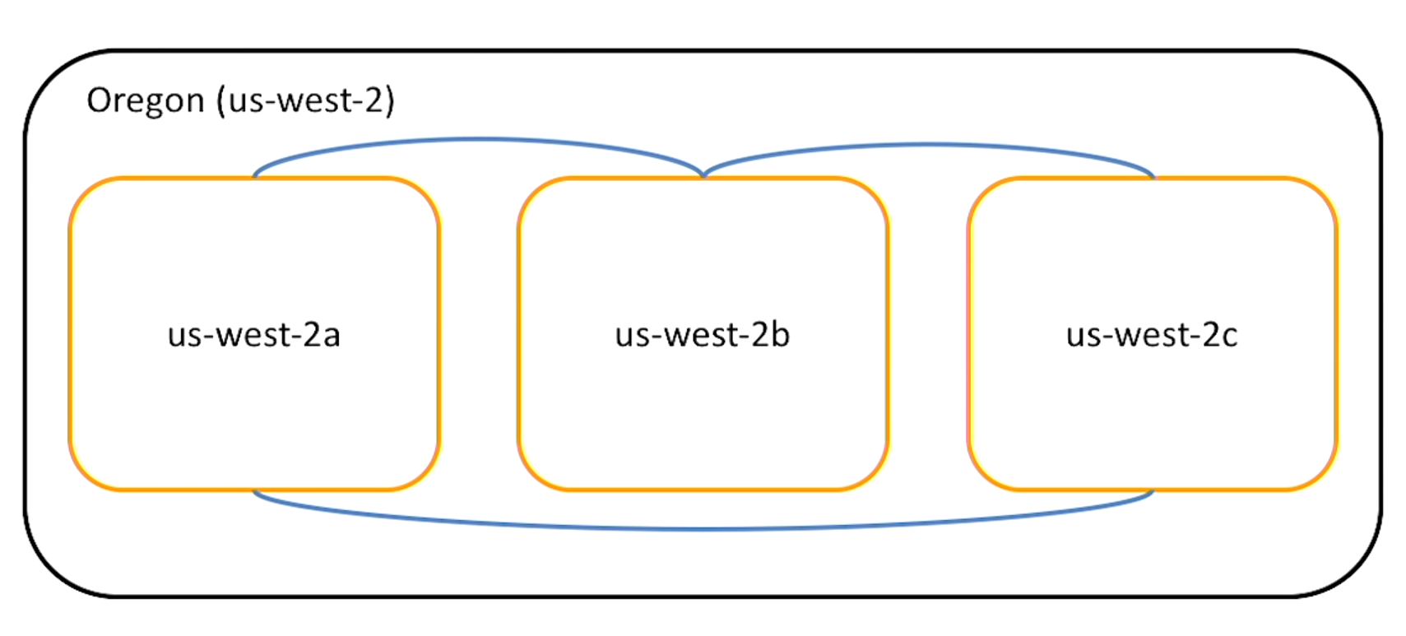

Slide 14
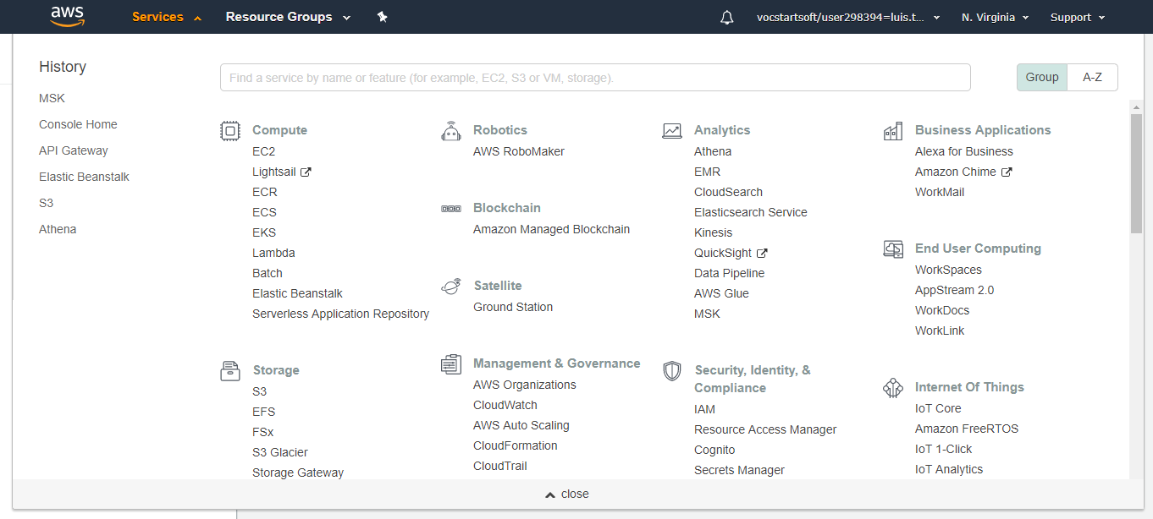
Service Overview

Slide 15
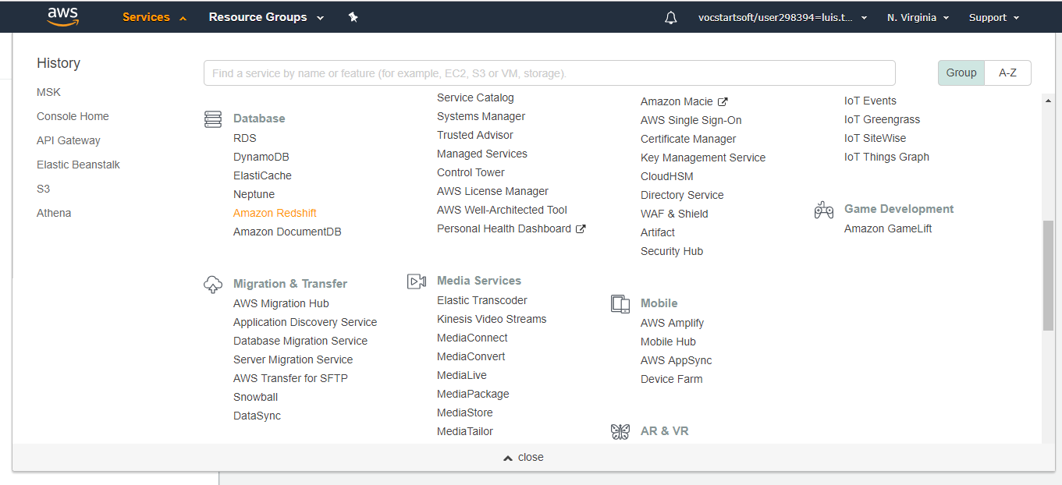

Slide 16
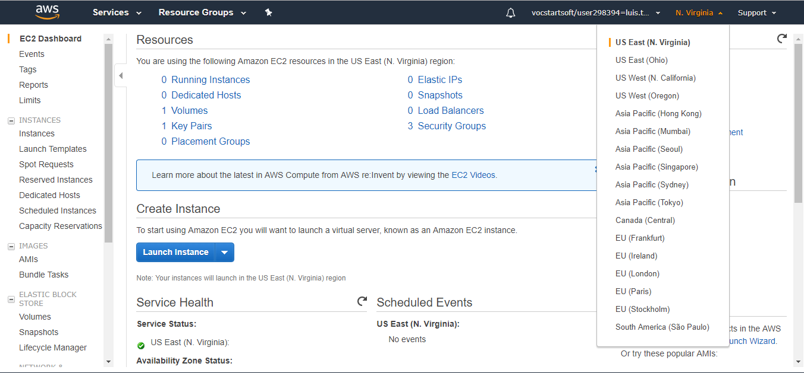

Slide 17
EC2, S3, RDSA

Slide 18

Computing in AWS

Slide 19
Introduction to AMazon Elastic Compute Cloud (EC2)
Virtual Machine
Various Combinations of CPU, memory, disk, IO
One virtual machine called an instance
Launch 1 to thousands*
Amazon Machine Image (AMI)

Slide 20
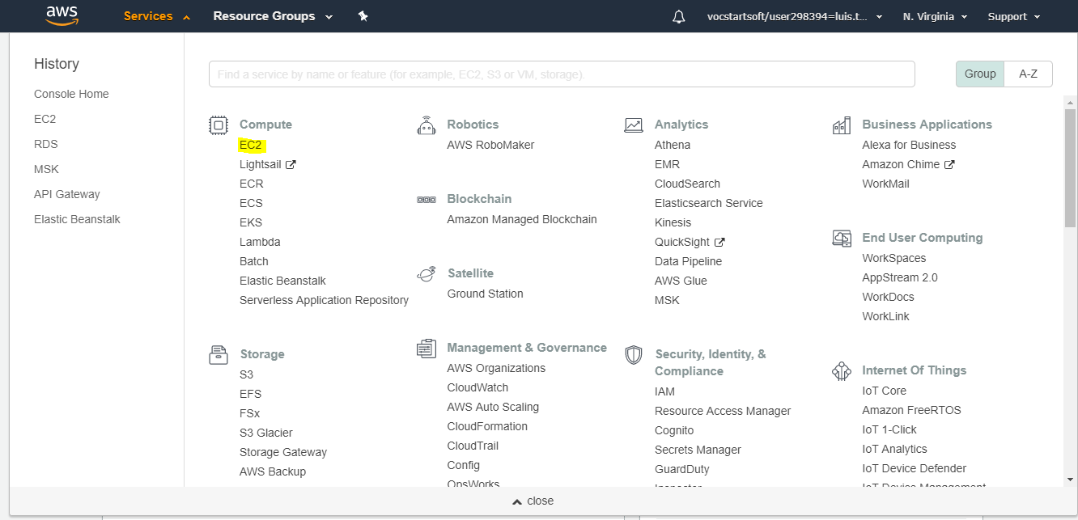
Demo launching a Linux Instance

Slide 21
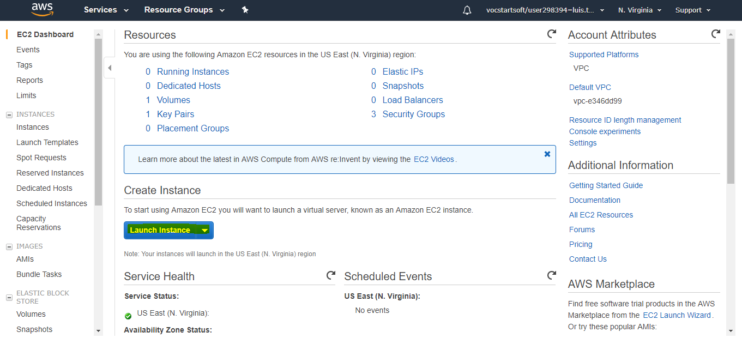
Create a Instance

Slide 22
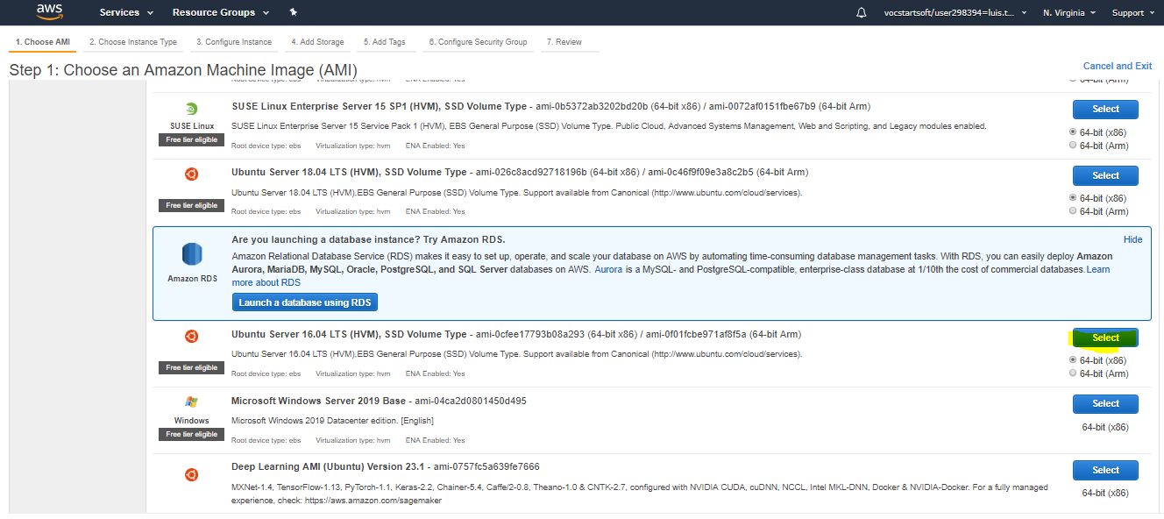
Choose an Amazon IMAGE

Slide 23
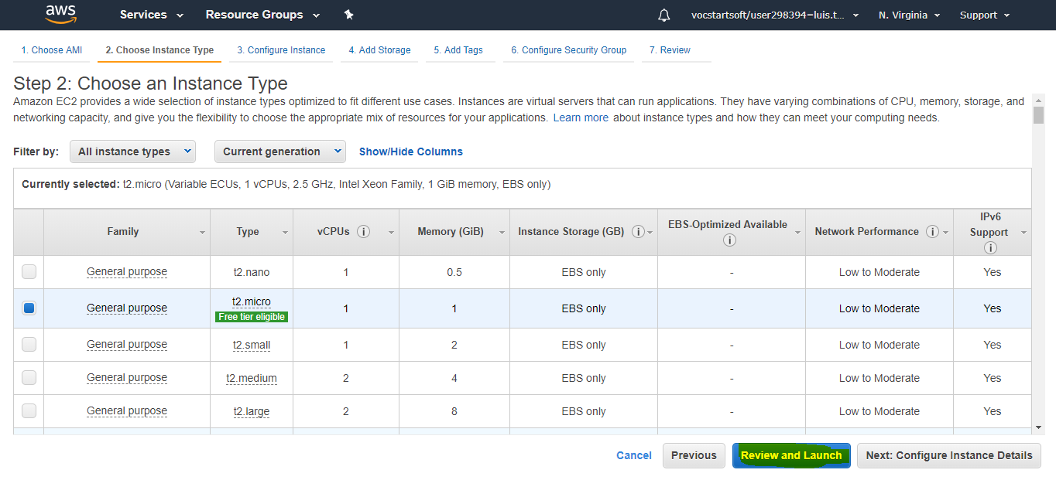
Choose an instance Type

Slide 24
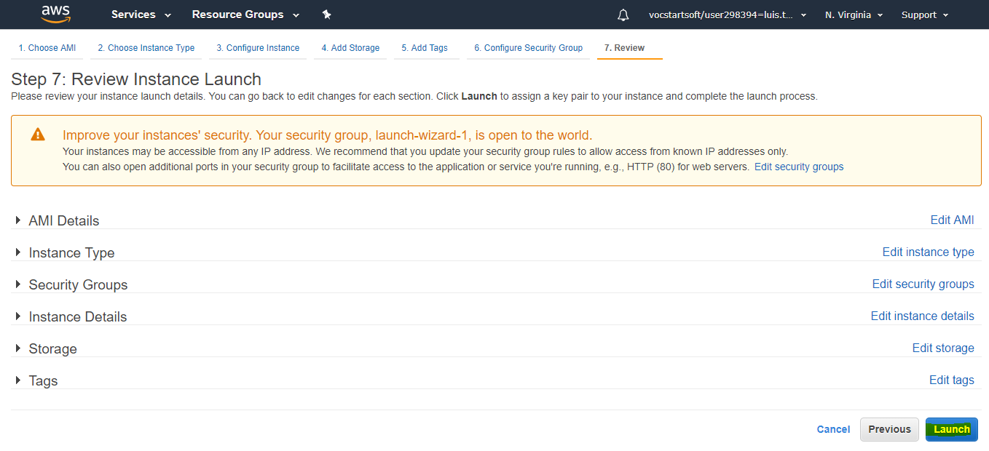
lAUNCHING A INSTANCE

Slide 25
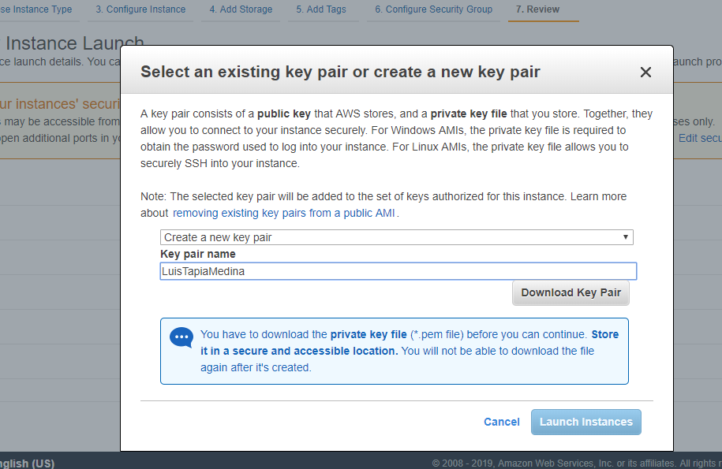
Select an Existing Key pair or create a new key pair
Click Download Key Pair
Launch Instances

Slide 26
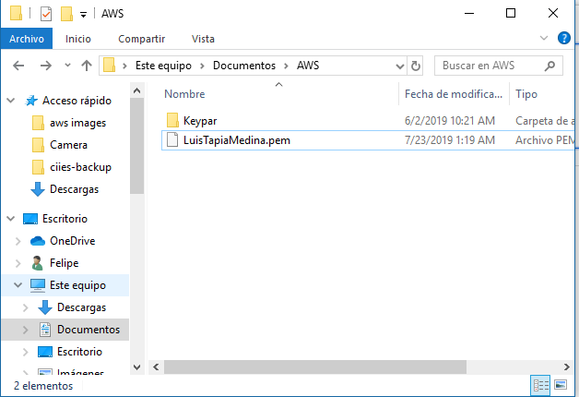
Check the PEM FILE

Slide 27
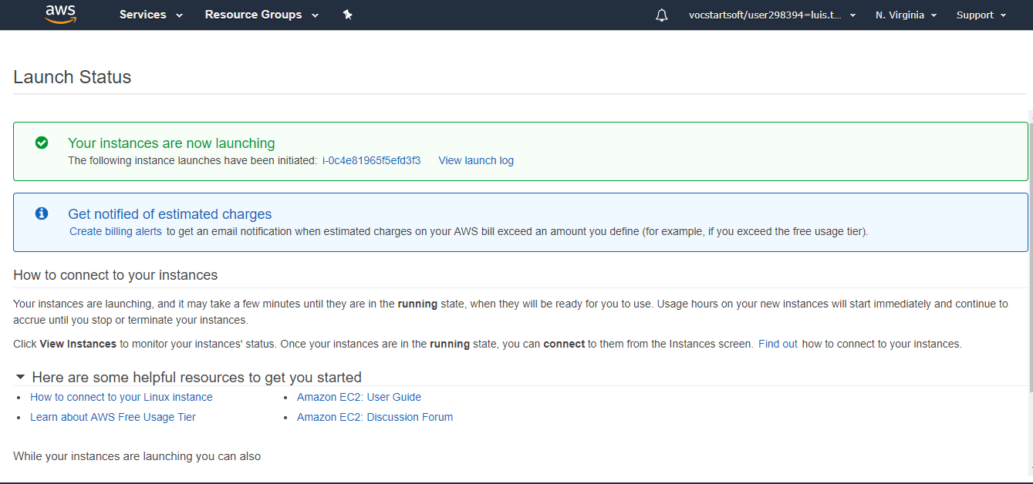

Slide 28
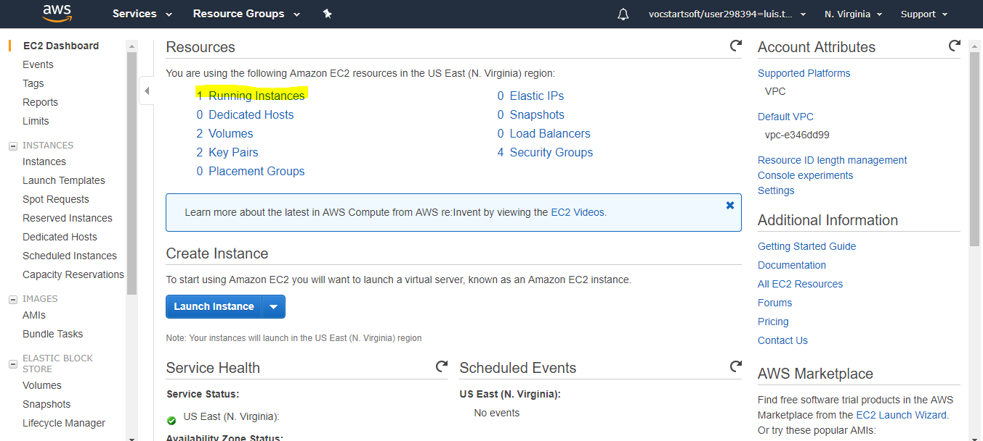
Running Instances

Slide 29
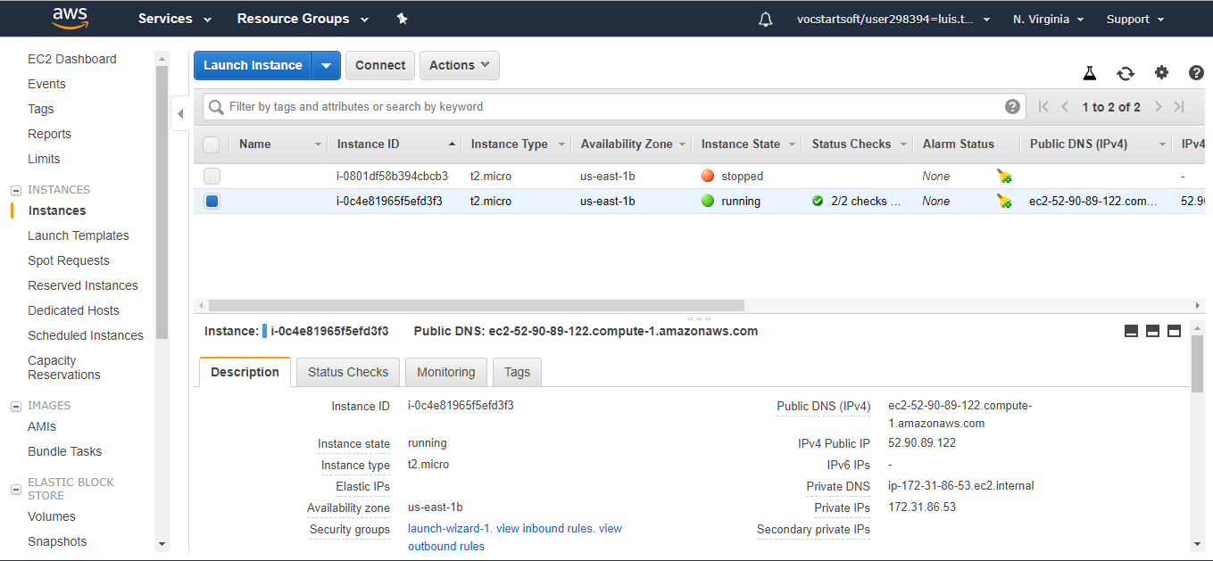
Check Your instance

Slide 30
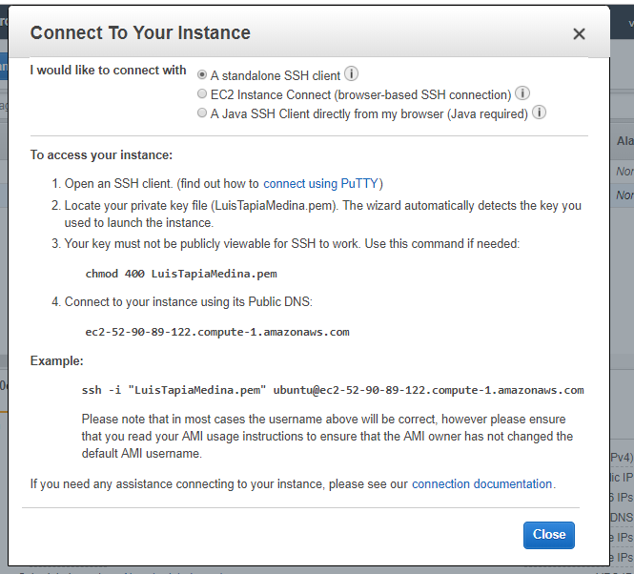
Connect to Your instance

Slide 31
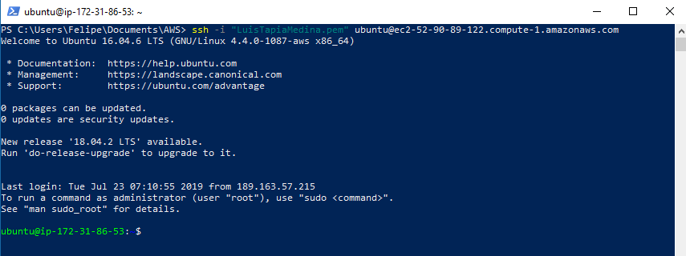
Windows Powershell

Slide 32
7 clicks
How many clicks do you need to run an instance?

Slide 33


exercise “Run a REST API USING Flask and Python”
sudo apt-get update
sudo apt install python
sudo apt install python-pip
sudo pip install flask

Slide 34
How can i start?
Amazon Educate offers a carrier.
Center of sharing.

